Slide 1

BLOOD BANK MANAGEMENT SYSTEM

Slide 2
OVERVIEW
The aim of this project is to create an online Blood Bank Management System. The entire project has been developed keeping in view of Java Database Connectivity.
The Agenda is to create an e-Information about the donor or the organization are related to donating the blood and the receiver or the organization in need of the blood. Through this application any individual or organization who is interested in donating the blood can register himself. Moreover if any general consumer wants to make request blood online he can also take the help of this site.
Using the constructs of MySQL Server and the database connectivity, it is planned using the “SQL Connection” methodology. The standards of security and data protective mechanism have been given a big choice for proper usage.

Slide 3
INTRODUCTION
The project blood bank management system is known to be a pilot project that is designed for the blood bank to gather blood from various sources and distribute it to the needy people who have high requirements for it.
The software is designed to handle the daily transactions of the blood bank and search the details when required.
It also helps to register the details of donors, blood collection details and blood packets available .
The software application is designed in such a manner that it can suit the needs of all the blood bank requirements in the course of future.

Slide 4
PROBLEM STATEMENT
Scarcity of rare blood group.
Unavailability of blood during emergency.
Less awareness among people about blood donation and blood transfusion.
Deaths due to lack of blood during operations.
The blood bank management system project aims to make all the procedures automated and therefore with computer system it can be more fast and accurate.
This project is a high quality software to manage all these cumbersome jobs.

Slide 5
SOFTWARE REQUIREMENTS
SQL Server
XAMPP(To Execute SQL Queries)
NetBeans IDE with Java SE
Windows OS

Slide 6
AWT Class
Java.awt
Java AWT (Abstract Window Toolkit) is an API to develop GUI or window-based applications in java.
Java AWT components are platform dependent i.e. components are displayed according to the view of operating system.
AWT is heavy weight i.e. its components are using the resources of OS.
The java.awt package provides classes for AWT API such as TextField, Label, TextArea, RadioButton, CheckBox, Choice, List etc.

Slide 7
Swing Class
Javax.Swing
Swing is a part of JFC(Java Foundation Classes). Building Graphical User Interface in Java requires the use of Swings. Swing Framework contain a large set of components which allow high level of customization and provide rich functionalities, and is used to create window based applications.
Java swing components are light weight, platform independent, provide powerful components like tables, scroll panels, buttons, list, color chooser, etc.

Slide 8
My SQL
SQL (Structured Query Language) is used to perform operations on the records stored in database such as updating records, deleting records, creating and modifying tables, views etc.
SQL is just a query language, it is not a database. To perform SQL queries, you need to install any database for example Oracle, MySQL, MongoDB, SQLServer,DB2, XAMPP, etc.
SQL is required:
o To create new databases, tables and views
o To insert records in a database
o To update records in a database
o To delete records from a database
o To retrieve data from a database

Slide 9
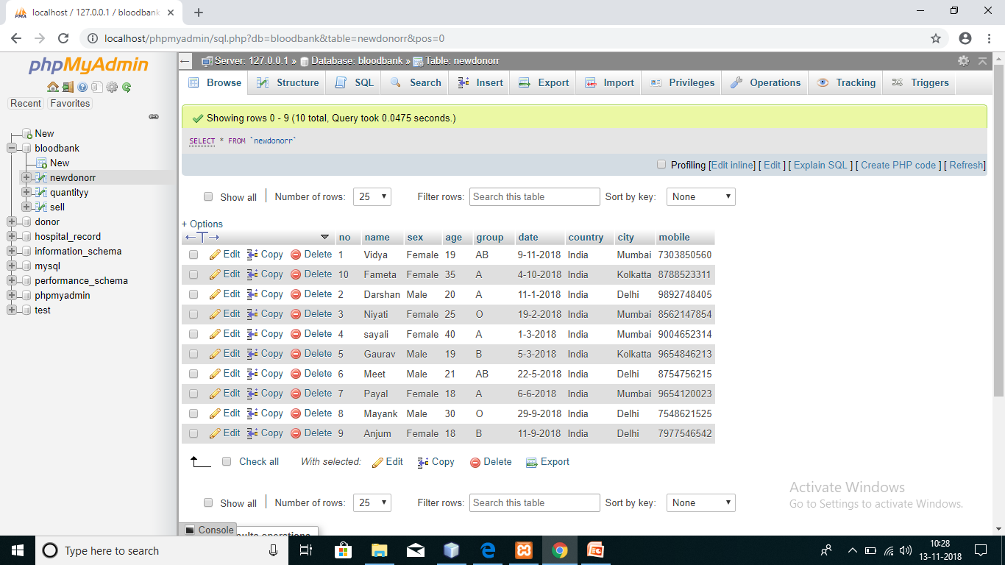

Slide 10
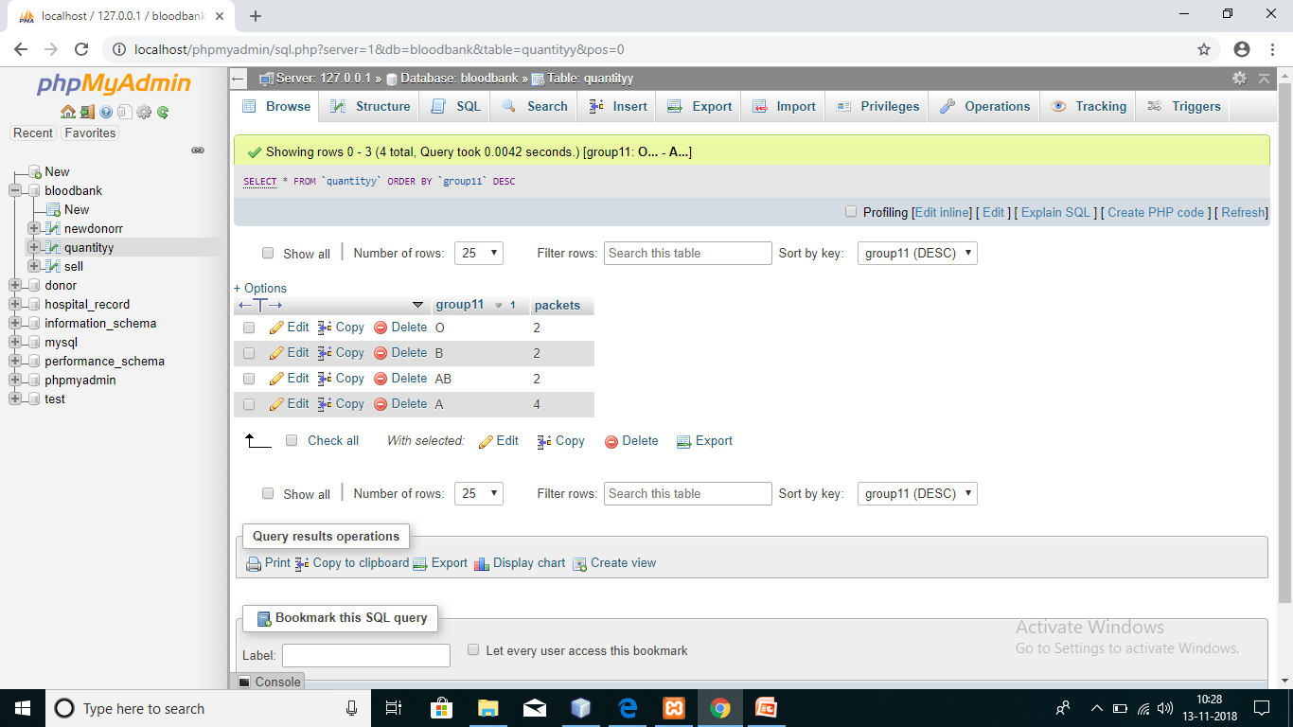

Slide 11
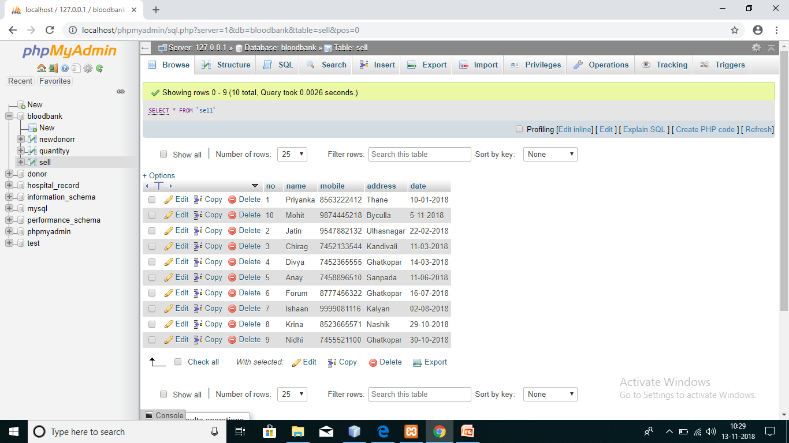

Slide 12
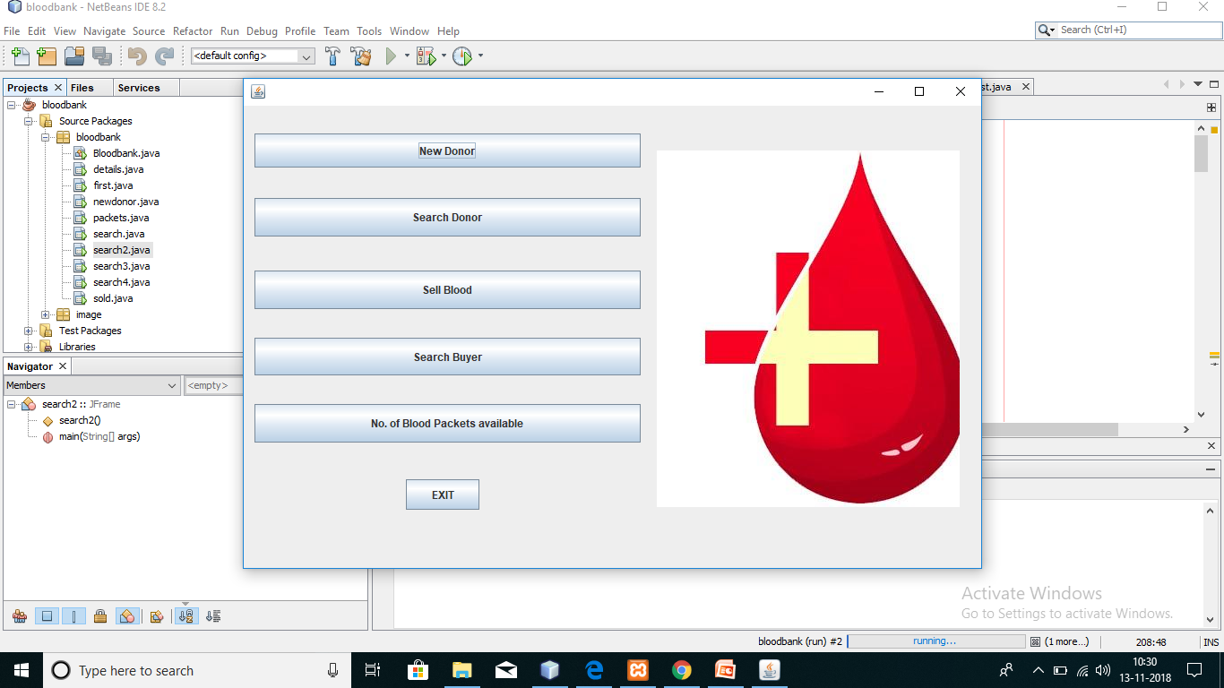

Slide 13
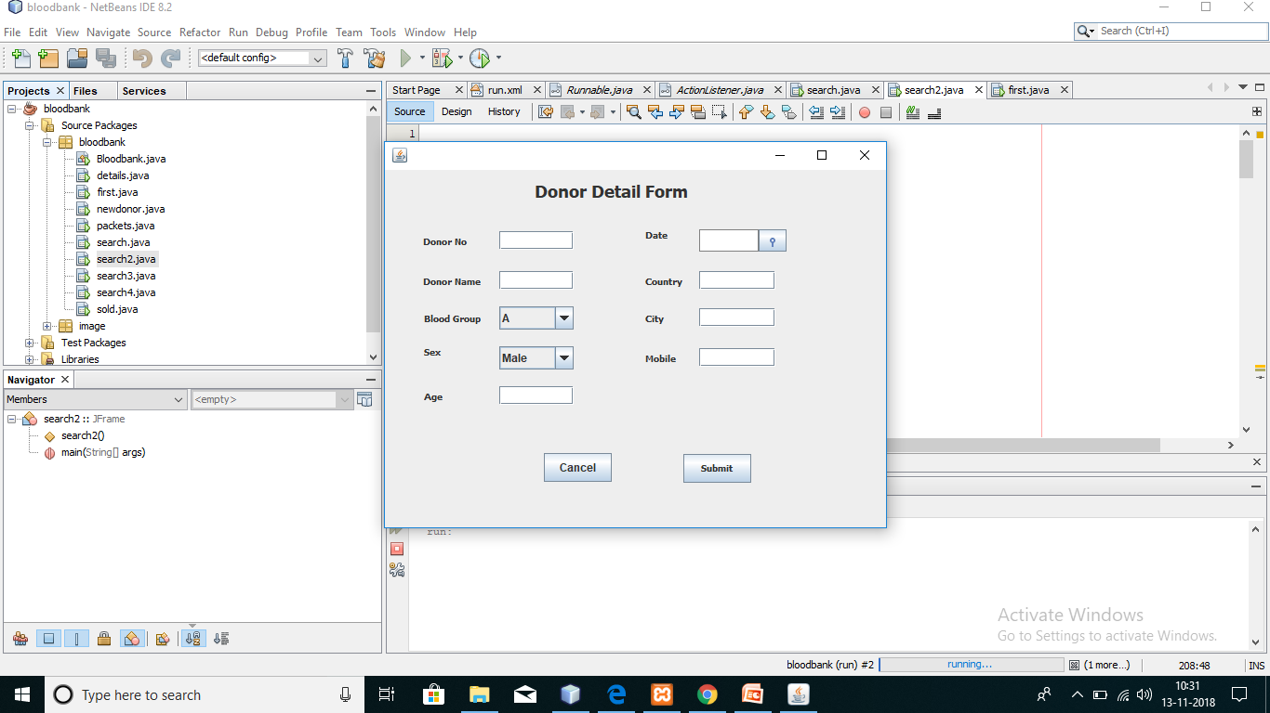

Slide 14
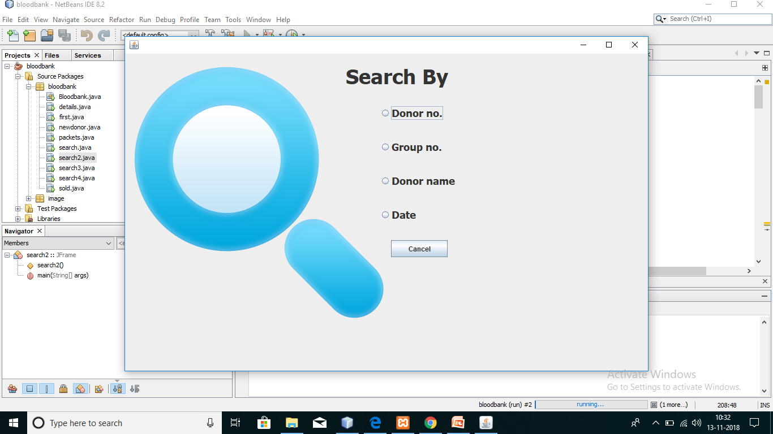

Slide 15
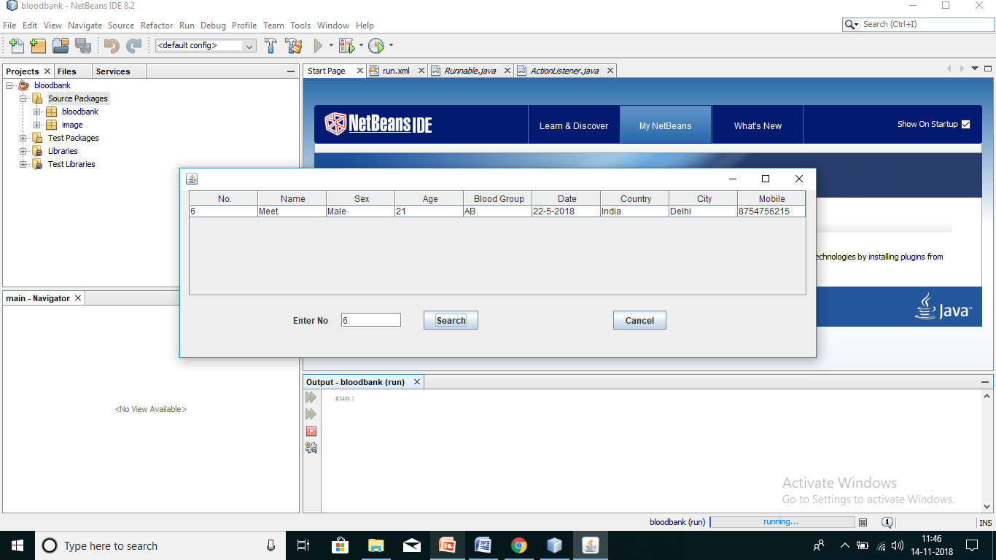

Slide 16
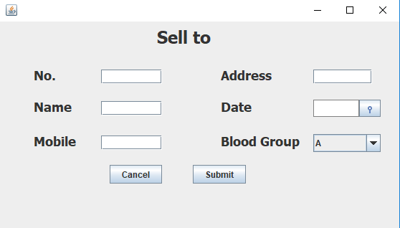

Slide 17
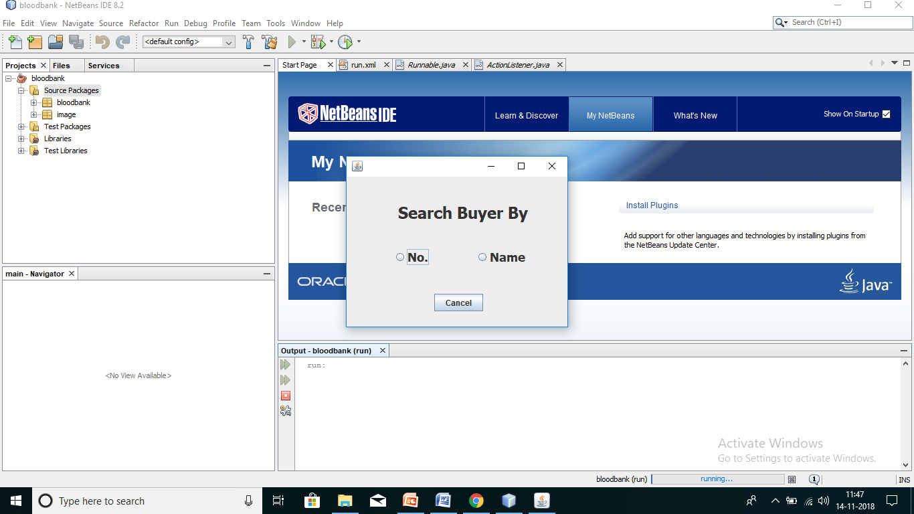

Slide 18
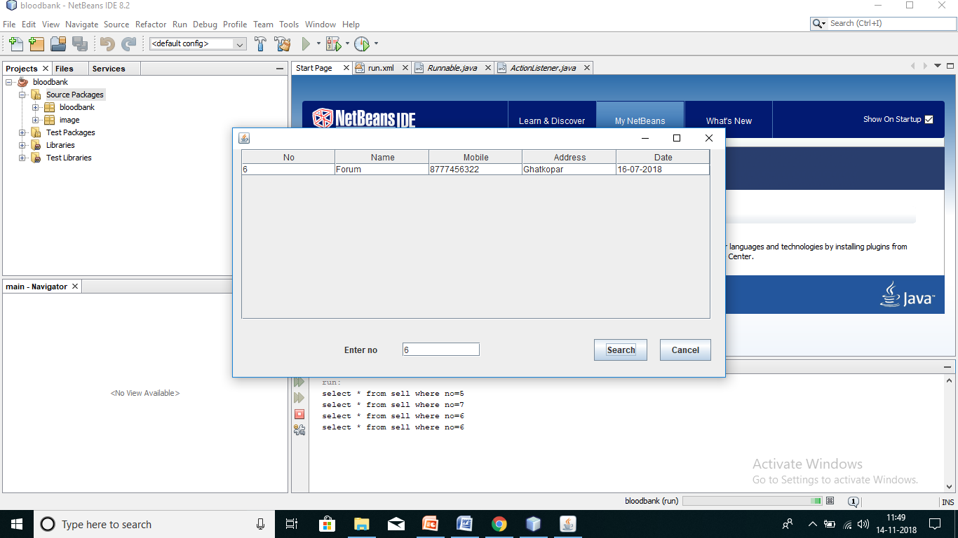

Slide 19


Slide 20
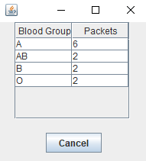

Slide 21
ADVANTAGES
User friendliness is provided in the application with various controls.
The system makes the overall project management much easier and flexible.
Readily upload the latest updates in the database.

Slide 22
CONCLUSION
It has been a great pleasure for us to work on this exciting and challenging project. This project proved good for us as it provided practical knowledge of not only programming in web based application and to some extent Windows Application and SQL Server, but also about all handling procedure related with “Blood Bank Management System”. It also provides knowledge about the latest technology used in developing web enabled application and client server technology that will be great demand in future. This will provide better opportunities and guidance in future in developing projects independently.

Slide 23
BENEFITS
It’s a web-enabled project.
This project offers user to enter the data through simple and interactive forms. This is very helpful for the client to enter the desired information through so much simplicity.
Data storage and retrieval will become faster and easier to maintain because data is stored in a systematic manner and in a single database.
Decision making process would be greatly enhanced because of faster processing of information since data collection from information available on computer takes much less time then manual system.
Allocating of sample results becomes much faster because at a time the user can see the records of last years.

Slide 24
LIMITATIONS
The size of the database increases day-by-day, increasing the load on the database back up and data maintenance activity.
Training in database connectivity for simple computer operations is necessary for the users working on the system.

Slide 25

THANK YOU

